Slide 1
Young People Who Experience Trauma: Identifying Strategies to Promote Resilience and Reduce Future Perpetration of Violence
April 2-3, 2012 Summit
Washington, DC

Slide 2
Expert Panel
Dr. Sarah Oberlander (Facilitator)
  Social Science Analyst, U.S. Department of Health and Human Services
Dr. Bradley Stolbach
  Director, La Rabida Children’s Hospital Chicago Child Trauma Center; Associate Professor of Clinical Pediatrics, The University of Chicago Pritzker School of Medicine
Eric Lulow
  Youth Involvement Associate, National Federation of Families for Children's Mental Health
Julia Silva
  Director, Violence Prevention Office, American Psychological Association

Slide 3
Trauma and Adverse Childhood Experiences
Dr. Bradley Stolbach

Slide 4
Traumatic Stressors in
Chicago Child Trauma Center Clients
Sexual abuse 55%
Witnessed domestic violence 39%
Physical abuse 27%
Traumatic loss 26%
Witnessed physical or sexual abuse 26%
Witnessed community violence 19%
Motor vehicle accident 13%
Other medical trauma (other than burns) 12%
Victim of extrafamilial violent crime 7%
Burns 7%
Fire 7%
Witnessed homicide 5%
Other (e.g., dog attack, school violence, abduction, torture, witnessing serious injury, hurricane)
Source: Stolbach et al., 2009

Slide 5
Other Adverse Experiences in
Chicago Child Trauma Center Clients
Impaired caregiver 54%
Neglect 37%
Placement in foster care 30%
Death of significant other (not TL) 26%
Unresolved trauma history in caregiver 24%
Exposure to drug use or criminal activity in home 23%
Emotional abuse 22%
Exposure to prostitution or other developmentally inappropriate sexual behavior in home 18%
Substitute care (not foster care) 17%
Incarcerated family member 16%
Homelessness 7%
Source: Stolbach et al., 2009

Slide 6
What is Complex Trauma?
Exposure to multiple forms of violence and other potentially traumatic stressors in the context of attachment behavioral systems that are unable to provide protection, care, and comfort.
Focus on cumulative trauma and the developmental context in which exposure occurs rather than on discrete episodes.
Individuals with a trauma history rarely experience only a single traumatic event.
  Nearly 40% had experienced two or more types of direct victimization in the past year (Finkelhor et al., 2009).
  Fewer than 24% had experienced only one type of trauma or adverse childhood experience; over 40% had experienced 4 or more (NCTSN Core Data Set, 2012).

Slide 7
Proposed Developmental Trauma Disorder Criterion A:
A. Exposure. The child or adolescent has experienced or witnessed multiple or prolonged adverse events over a period of at least one year beginning in childhood or early adolescence, including:
  A. 1. Direct experience or witnessing of repeated and severe episodes of interpersonal violence; and
  A. 2. Significant disruptions of protective caregiving as the result of repeated changes in primary caregiver; repeated separation from the primary caregiver; or exposure to severe and persistent emotional abuse.

Slide 8
Attachment Behavioral System
Attachment: an evolved behavioral system that functions to promote the protection and safety of the attached person.
Attachment system is activated strongly by internal and external stressors or threats.
It is through healthy attachment (i.e., a behavioral system that effectively protects and comforts the infant or child) that a child develops the capacity for emotional and behavioral self-regulation, as well as a coherent self.
These developmental capacities shape the way that individuals experience and respond to trauma.

Slide 9
Some Basic Assumptions About Psychological Traumatization
Traumatic experiences are those which overwhelm an individual’s capacity to integrate experience in the normal way (e.g., Putnam, 1985).
Following exposure to trauma, if integration does not occur, traumatic experience(s) are split off and an individual alternates between functioning as if the trauma is still occurring and functioning as if the trauma never occurred (e.g., Nijenhuis et al., 2004).
Although traumatic memories and associations remain inaccessible to consciousness much of the time, they have the power to shape an individual’s daily functioning and behavior (e.g., Allen, 1993).

Slide 10
Key Developmental Capacities Affected by Complex Trauma
Ability to modulate, tolerate, or recover from extreme affect states (strong emotions)
Regulation of bodily functions (sleeping, eating, elimination)
Capacity to know emotions or bodily states
Capacity to describe emotions or bodily states
Capacity to perceive threat, including reading of safety and danger cues
Capacity for self-protection
Capacity for self-soothing
Ability to initiate or sustain goal-directed behavior
Development of coherent self, identity
Capacity to regulate empathic arousal

Slide 11
Example: “Marie Therese”
Fire 1
Domestic violence 5
Impaired caregiver 5 - 20
Physical abuse 5, 15, 16
Sexual abuse/assault 7, 15, 16
Community violence 10
School violence 10 - 16
Extrafamilial violent crime victim 12 - 20
Motor vehicle accident 14, 19
Incarceration 17 - 21
Traumatic loss 18
Witnessing homicide 18, 19
Homelessness 19, 20
Employment in sex industry 19, 20
Burn 20
Total Types of Traumatic Stress 12
Total Types of Other Adverse Experiences 4

Slide 12
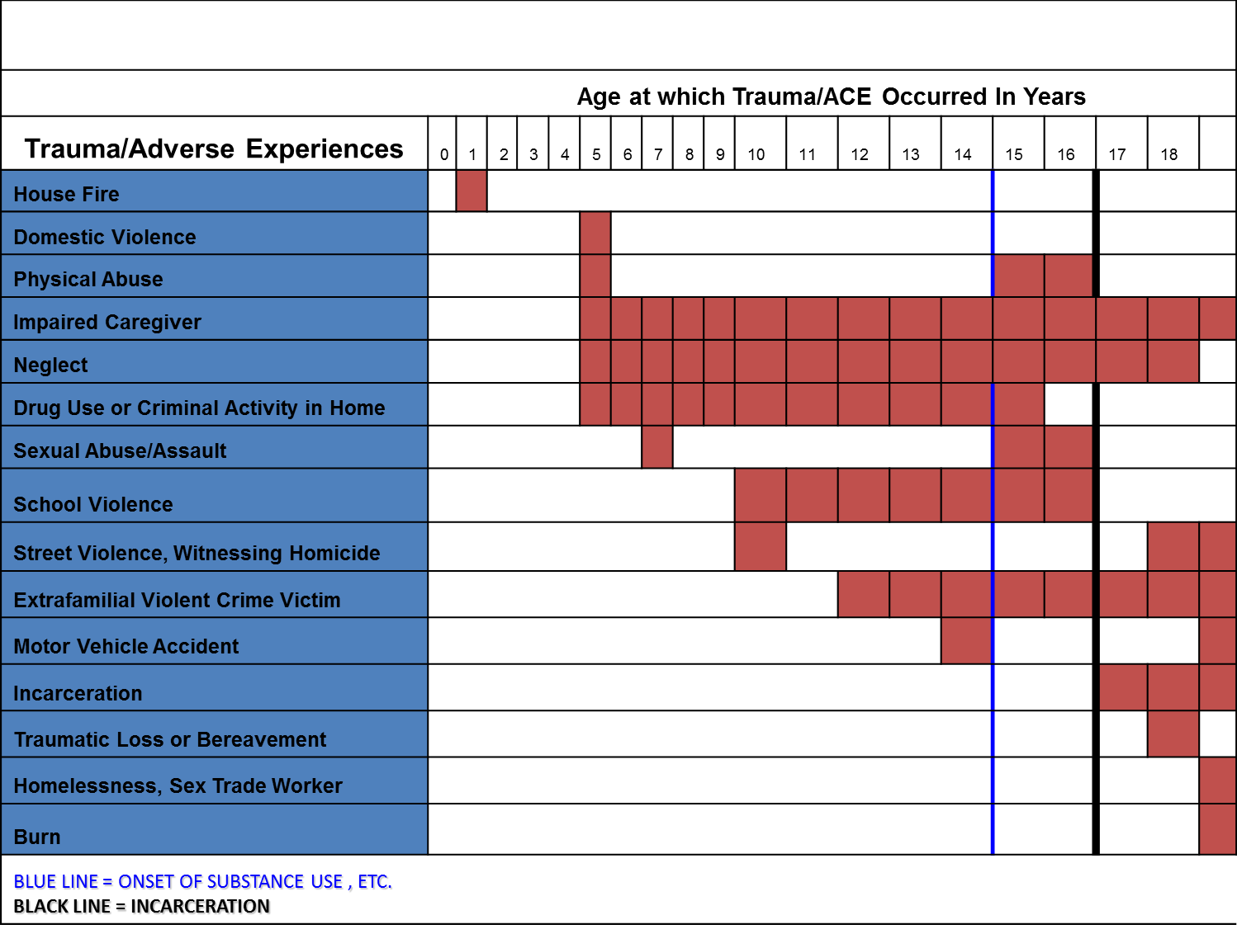
Trauma History Timeline: “Marie Therese”
Notes:
This graphic timeline shows traumatic and adverse experiences over the lifespan of Marie Therese.

Slide 13
Why Prevention is Critical: Trauma and Adverse Life Events of Incarcerated Girls (n=10)
Trauma
  100% had at least one form of family violence.
  80% had at least one form of ongoing traumatic stress.
  80% had at least one form of traumatic stress prior to age 6, including 30% who had exposure to violence from birth.
    Mean = 8.5; Range = 3 - 15
Adverse Life Events
  70% had impaired caregiver, incarcerated significant other, and exposure to drug use/criminal activity in home
  60% had neglect and death of significant other
    Mean = 4.8; Range = 2 – 8
Mean combined total types of traumatic stressors + other adverse childhood experiences = 13.3

Slide 14
Personal Account of Trauma and Adverse
Childhood Experiences
Eric Lulow

Slide 15
Personal Account of Childhood Stressors and Impacts
Eric Lulow’s Traumatic and Adverse Life Experiences:
  Witnessed domestic violence
  Physical abuse
  Witnessed physical or sexual abuse
  Witnessed community violence
  Impaired caregiver
  Neglect
  Placement in foster care
  Exposure to drug use or criminal activity in home
  Emotional abuse
  Incarcerated family member
  Homelessness
“I was dealing with all of these trauma stressors while trying to develop appropriate relationships with friends and family, find/maintain housing and employment, and attend school.”
- Eric Lulow

Slide 16
Trauma Informed Method of Engagement (T.I.M.E.)
Reflection
Relationship
Preparation
Provide Standard Training
Meet logistical needs
Support
Establish Trust & Rapport
Identify Trauma Triggers
Develop a Safety Plan
Target the Task
Practice new skills
Process/Debrief
Assess trauma triggers
Develop Personal and Professional skills
Assess strengths, needs, and situation
Check in
© Georgetown University National Technical Assistance Center for Children’s Mental Health. Cady, D & Lulow, E.
Notes:
This graphic shows a circle split into four quadrants, Reflection, Relationship, Support, and Preparation. The Reflection quadrant has three bullet points: process/debrief, assess trauma triggers, and develop personal and professional skills. The Relationship quadrant is explained as: establish trust and rapport, identify trauma triggers, and develop a safety plan. The Preparation quadrant has three associated bullet points: provide standard training, target the task, and practice new skills. The Support quadrant is explained as: meets logistical needs, assess strengths, needs, and situation, and check in. This figure was developed by D. Cady and Eric Lulow and is distributed by the Georgetown University National Technical Assistance Center for Children’s Mental Health.

Slide 17
Building Capacity of Providers to Identify and Appropriately
Treat Youth who are Victims
Julia Silva

Slide 18
Victimized Children and Youth
What they need:
  Help to Heal: be able to talk about the trauma on their own ways, have a sense that others believe them, that they are valued.
  Help to Build Resilience: the capacity to bounce back and adapt.
Can help by providing access to organizations and providers that adopt:
  Scientifically-supported assessment tools for trauma symptoms and impact; and
  Effective trauma-focused evidence-based treatments.

Slide 19
The Effective Providers for Child Victims of Violence Program (The EP Program)
A training program to increase the number of organizations and mental health and allied professionals informed about and prepared to adopt scientifically-supported assessment tools and family-centered, culturally sensitive, evidence-based treatments for children and youth who are victims of violence.
The EP Program Principles: Effective trauma-focused treatments
  Involve families/caregivers because they are central to treatment regardless of the child’s age.
  Use evidence-based treatments because they were tested and we know they work.
  Are provided by culturally competent providers because children and families come from diverse backgrounds.
  Are based on collaboration among professionals and systems of care because violence is too complex for one field and one system to tackle.

Slide 20
The EP Program Rationale
Effective treatments help:
Organizations increase productivity
Professionals accomplish their mission
Decrease re-victimization rate

Slide 21
The EP Program Model
Two-day workshops to train trainers to conduct 1-day community workshops. The curriculum addresses:
Impact of exposure to violence on children and youth.
Review of six trauma-focused assessment tools.
Review of five trauma-focused evidence-based treatment models.
The role of culture on victimization and treatment.
A family-centered collaborative approach to treatment.
For more information, visit: www.apa.org/pi/prevent-violence/programs/child-victims.aspx

Slide 22
Additional Information
Division of Violence Prevention, Centers for Disease Control and Prevention
http://www.cdc.gov/ViolencePrevention/index.html
National Child Traumatic Stress Network
http://www.nctsnet.org/
National Federation of Families for Children's Mental Health
http://ffcmh.org/
American Psychological Association
http://www.apa.org/pi/prevent-violence/index.aspx
The findings and conclusions in this presentation are those of the authors and do not necessarily represent the official position of the Centers for Disease Control and Prevention, National Child Traumatic Stress Network, National Federation of Families for Children’s Mental Health, and the American Psychological Association.

Slide 23
Discussion

